Slide 1

EotM UI

Slide 2
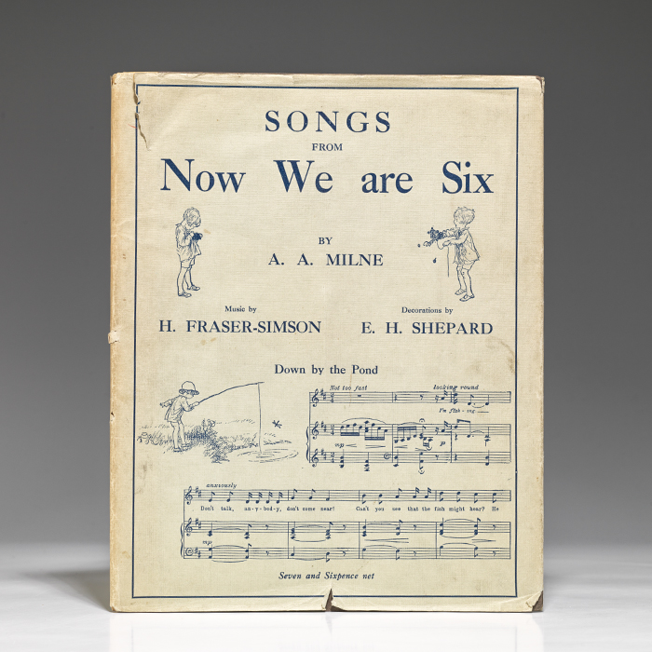
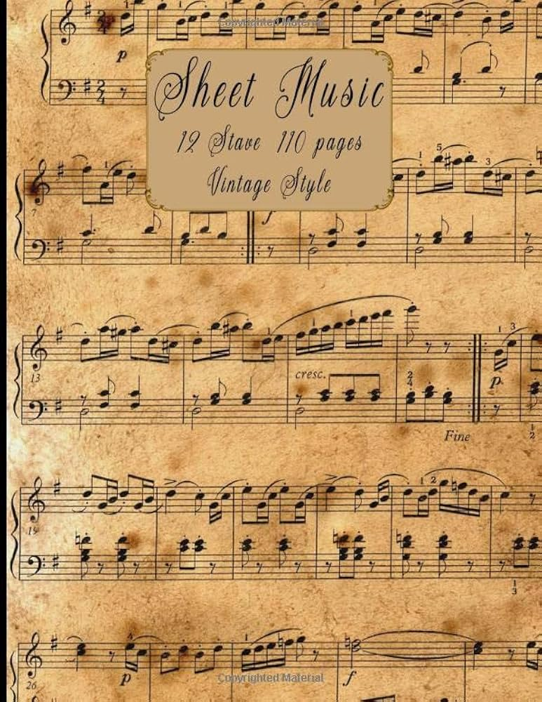
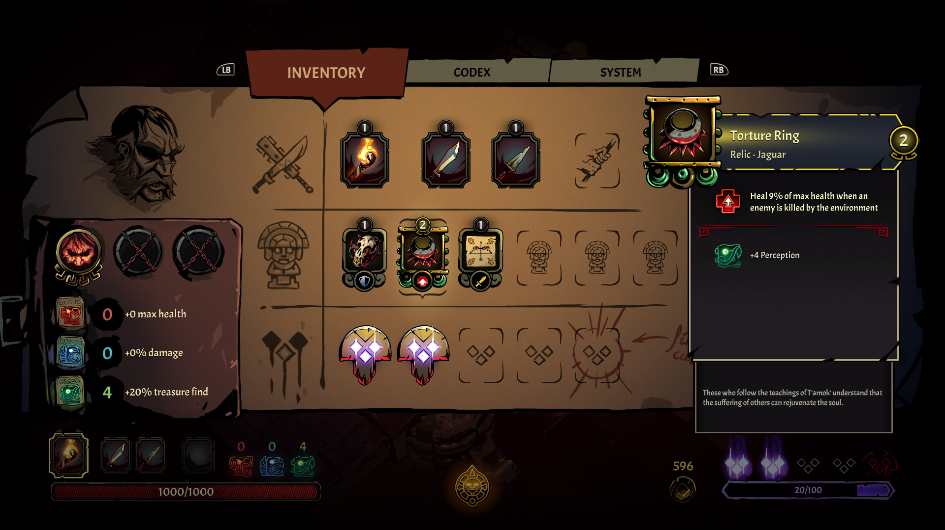
Mood
Curse Of The Dead Gods Layout
(Pause Menu + Inventory)
Music Sheet-books

Slide 3
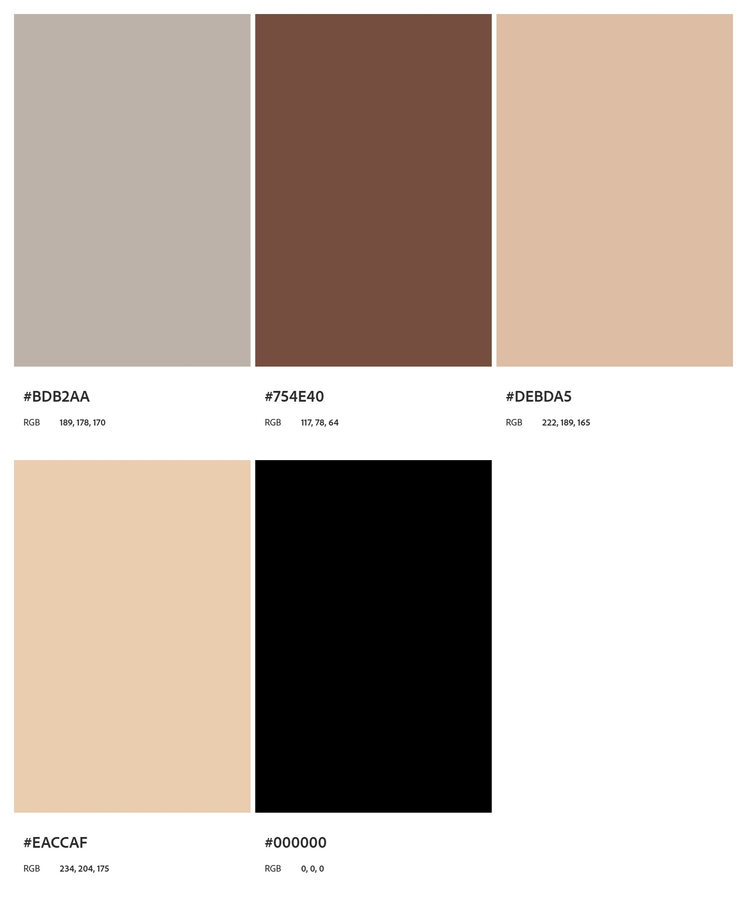
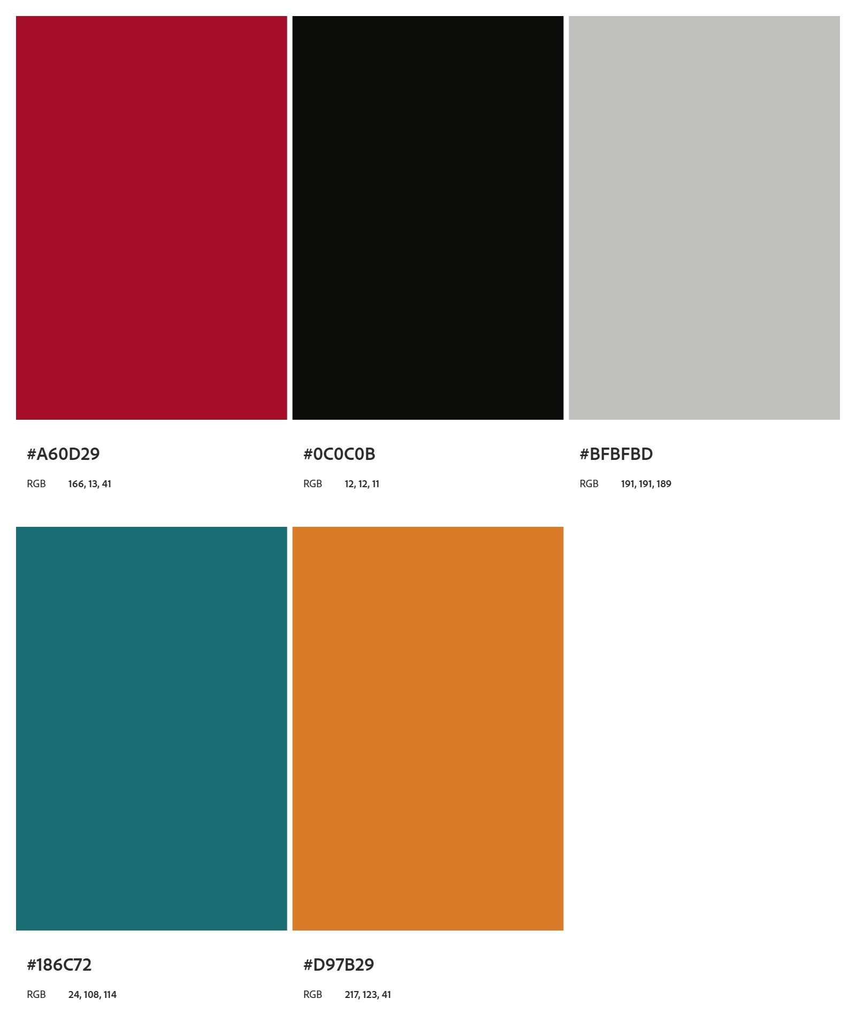
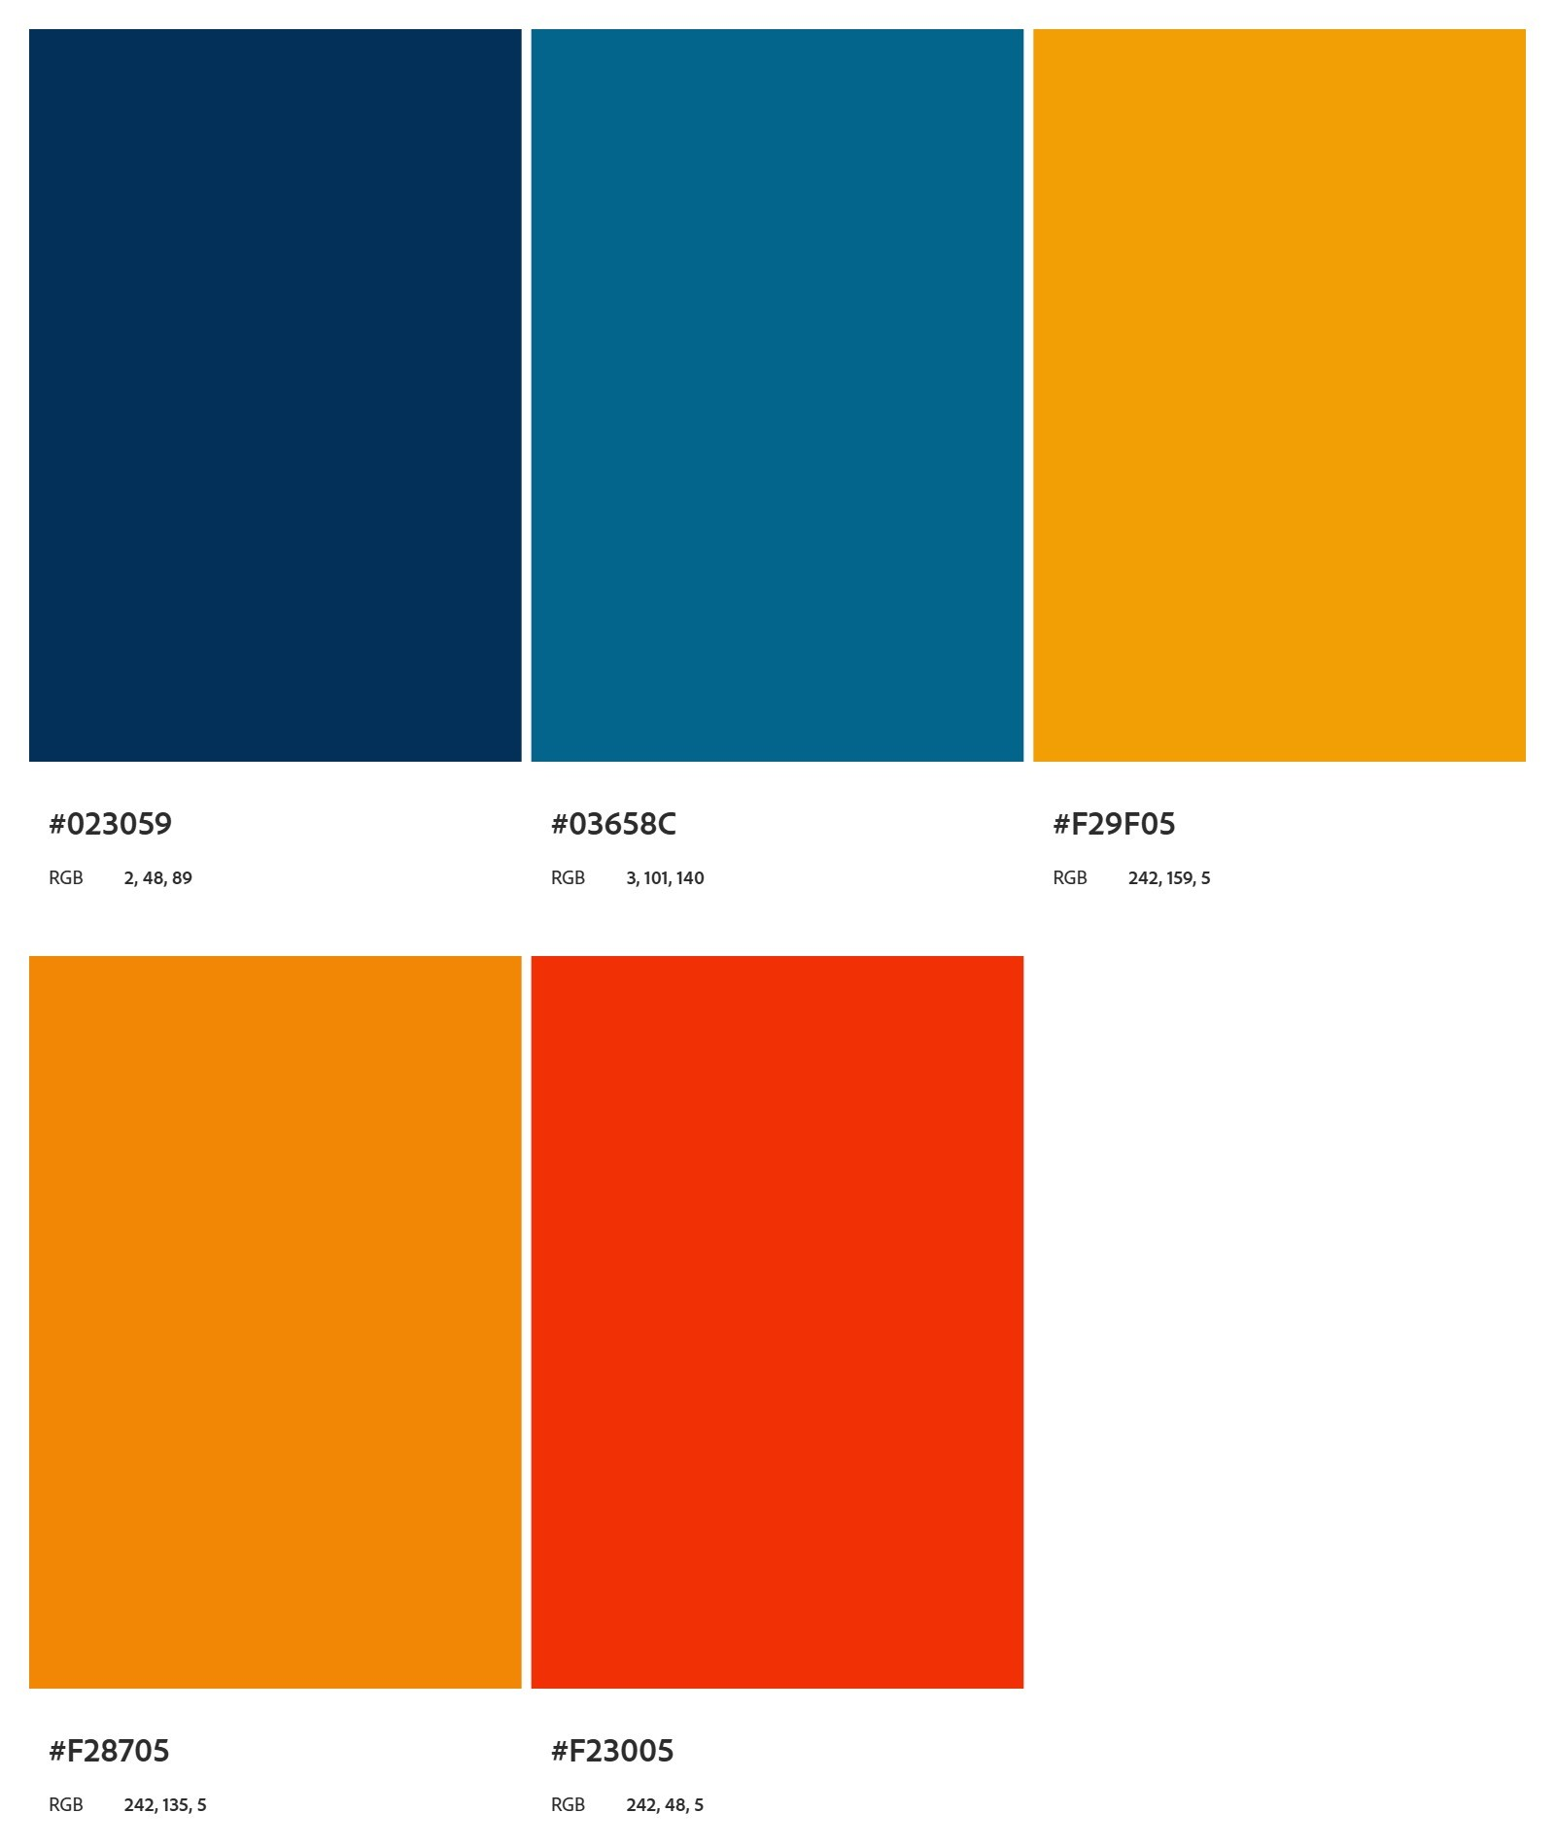
COLOR PALETTE
Iconography (Mostly to indicate the “Powers” of charms, masks or potions)
Main Color Palette

Slide 4
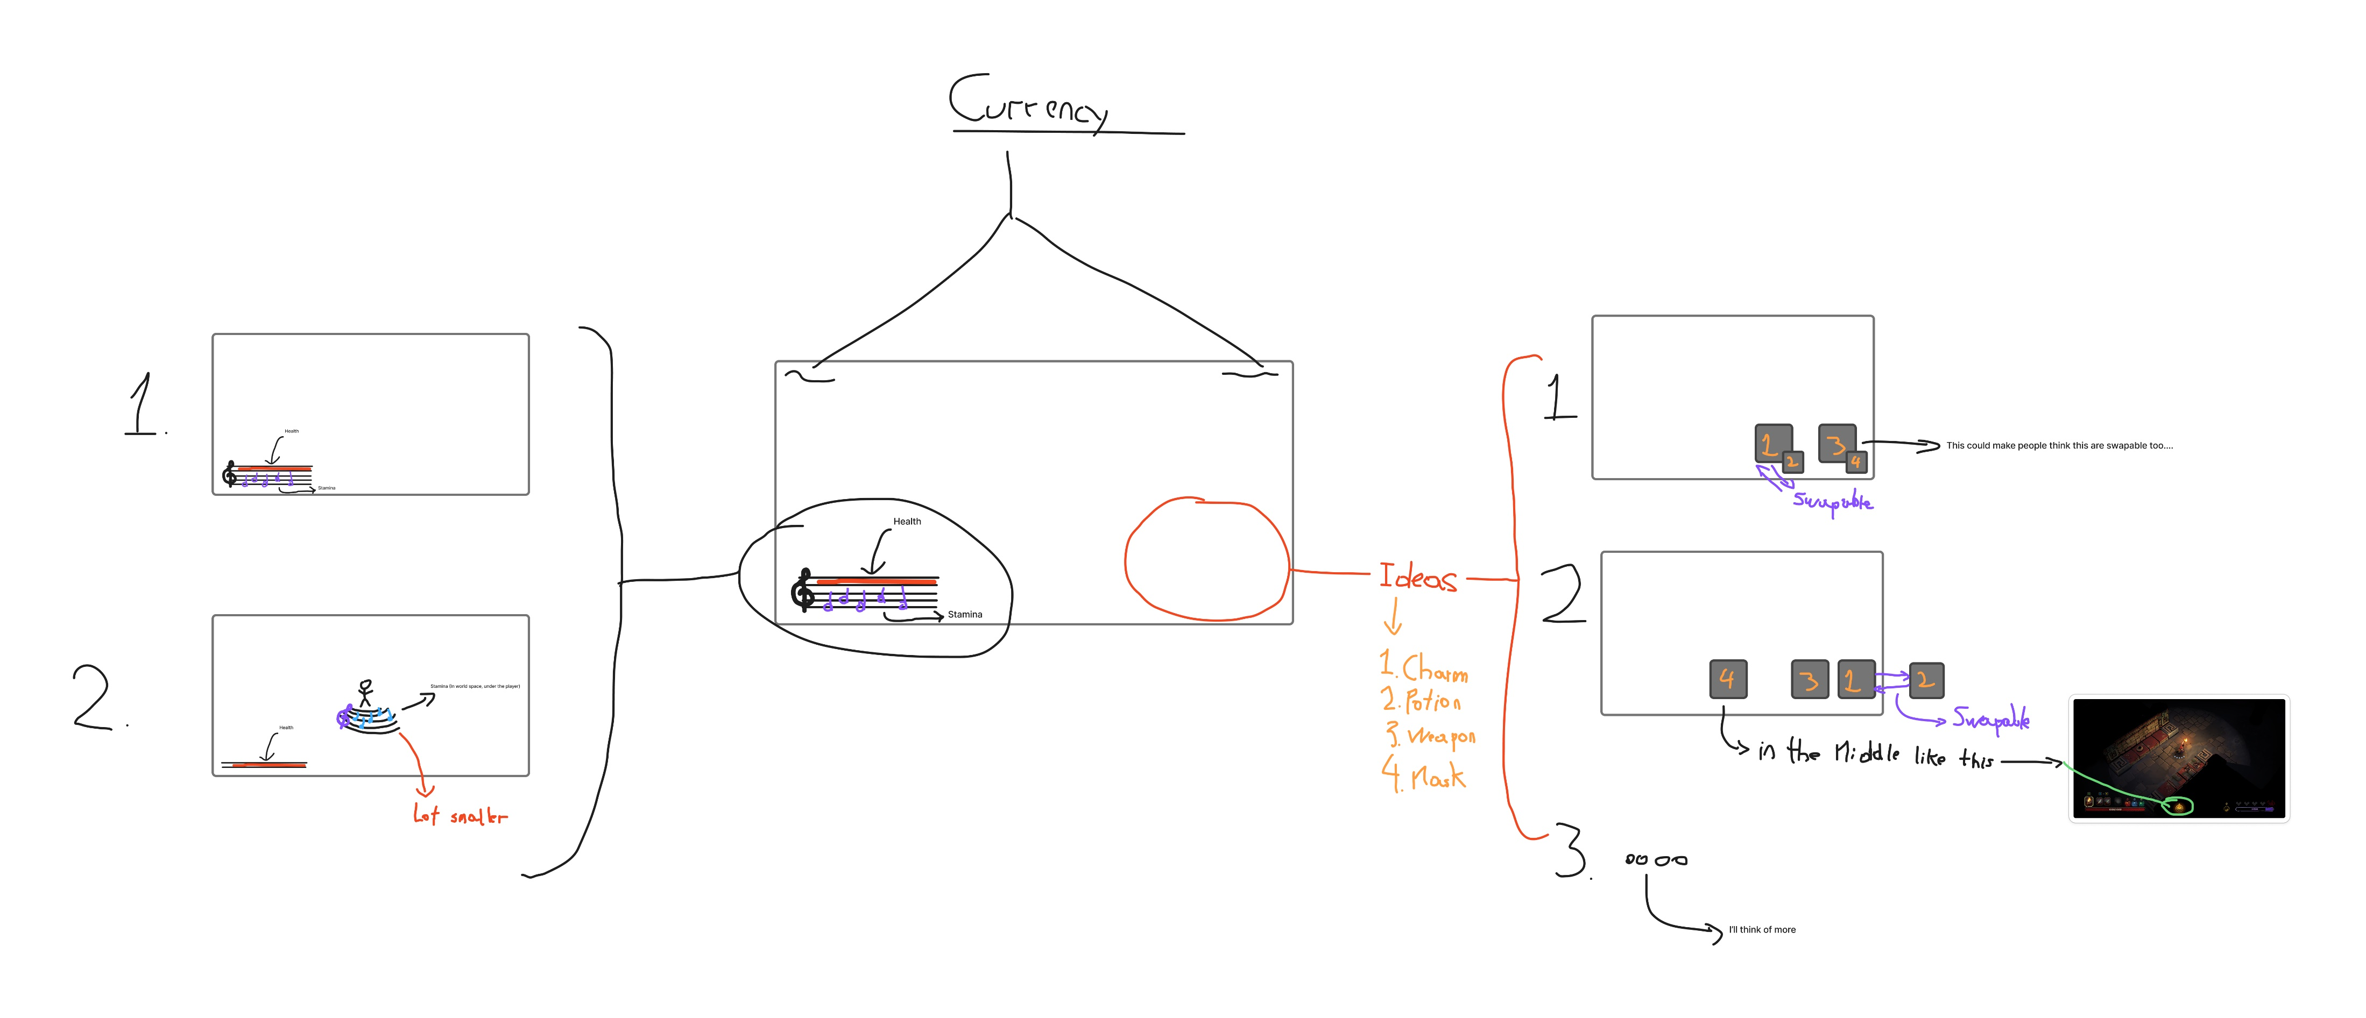
Concepts (HUD)
*HIGH QUALITY FILE IN DISCORD

Slide 5
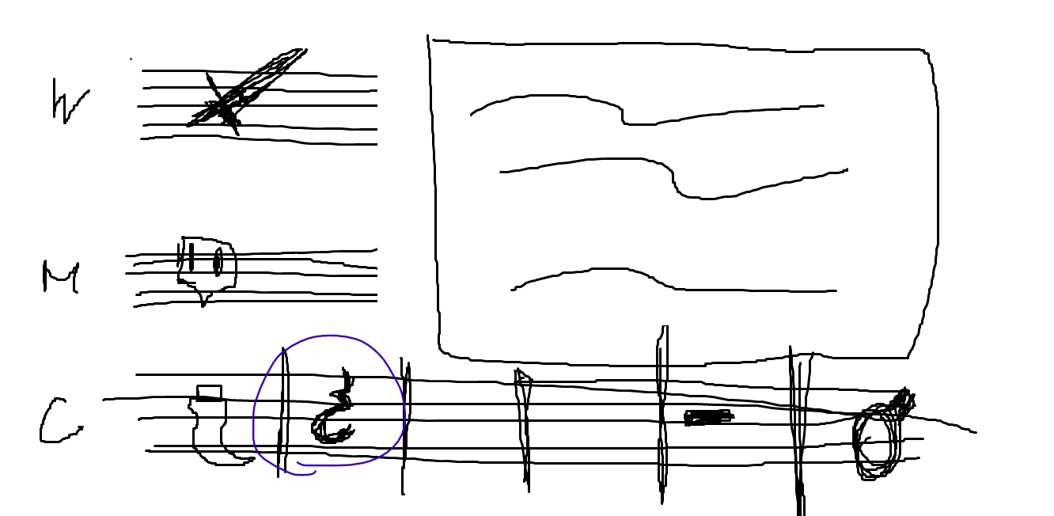
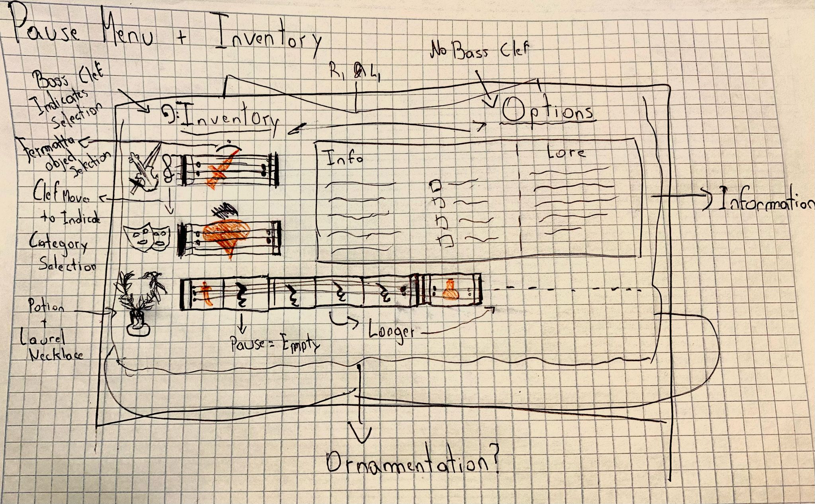
Concepts (Pause MENU & Inventory )

Slide 6
Concepts (SHOP)
*DOWNLOAD IT SO THAT YOU CAN SEE THE FULL QUALITY

Slide 7
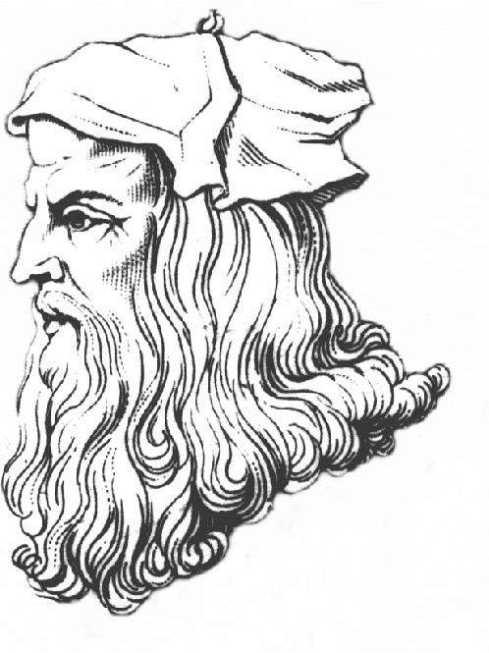
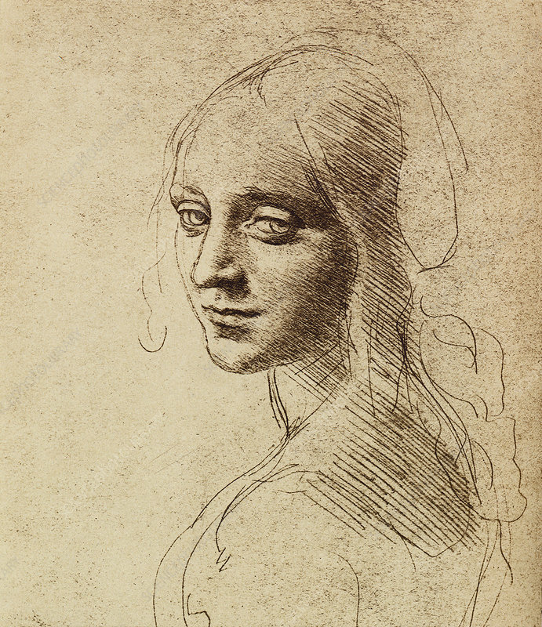
Most needed Assets
The style direction I'm aiming for regarding the UI elements.The overall aesthetic should feel hand-drawn and subtle, with an emphasis on elegance. This means that outlines, such as those used for pentagram lines, clefs, notes, and similar musical elements, should be thin and delicate, rather than bold or heavy.
By hand-drawn, I don’t mean sketchy or uneven, but rather with a bit of natural imperfection, like using a fine pen with slightly drying ink. So while the lines should remain clean and mostly straight (for example, pentagram lines shouldn’t have squiggles), they can have a soft, organic touch that gives a sense of being hand-rendered rather than digitally perfect.
Think of it as a refined, musical calligraphy style: clean structure, but with the warmth and charm of human imperfection.
Almost as if we were talking Line art type of approach

Slide 8

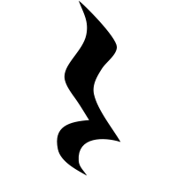
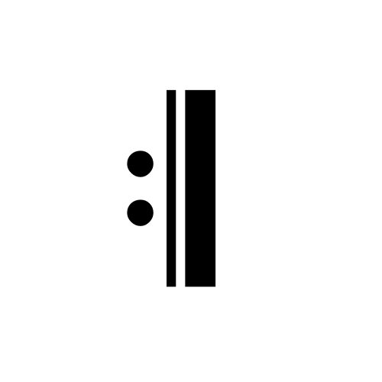
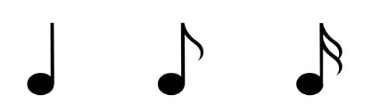

Most needed Assets
Pentagrams
Musical Notes
Clefs (Treble & Bass)
Pentagram Pauses
Types of Pauses we will use
Types of Notes we will use

Slide 9
Most needed Assets
Designs/Icons for Charms, Masks, Potion and Weapon
Iconography for Powers of charms, potions and mask (and also the currency)
Other Iconography (Cateogries in the inventory, Input [Controller and Keybaord icons], Arrows for navigation in the shop).
Slots (inventory and HUD) decored with musical ornamentation
Music ornamentation to add extra layers in corners or bottom, top and sides of the UI screens.

Slide 10
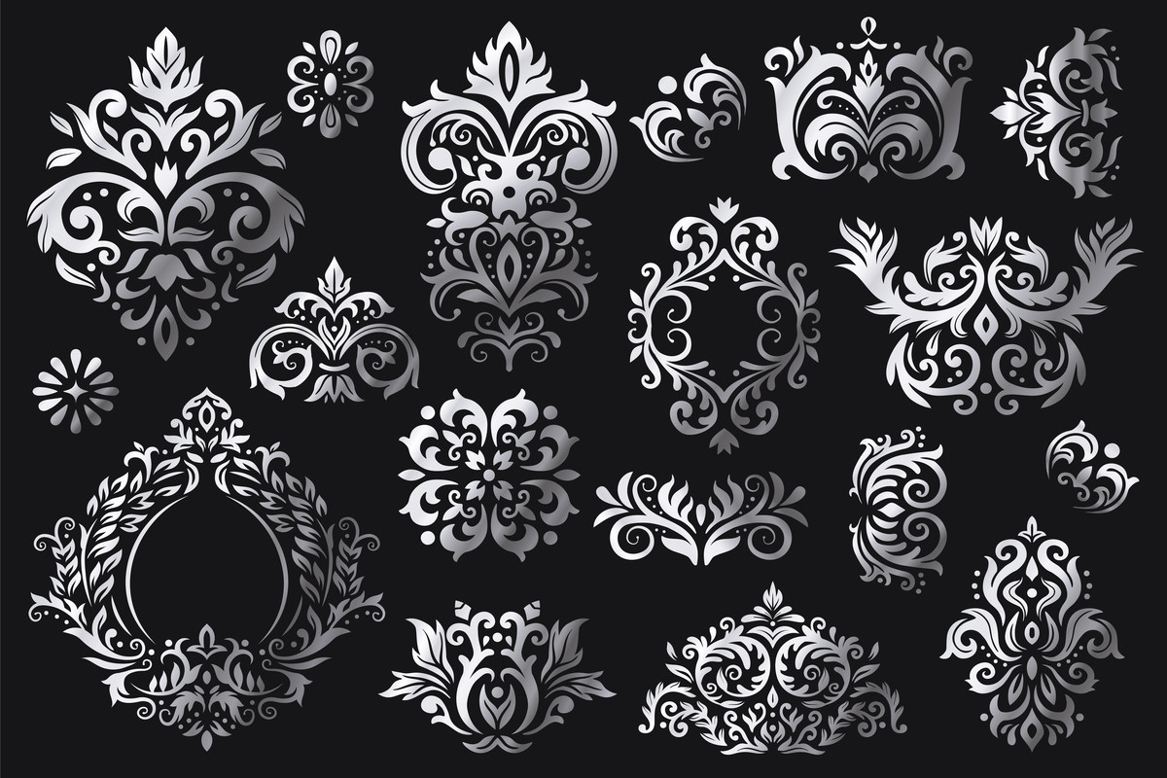
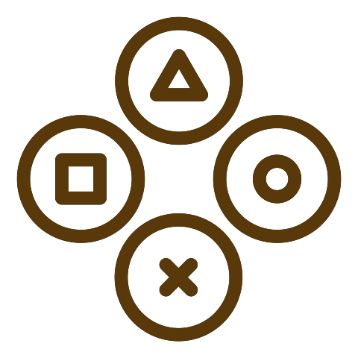
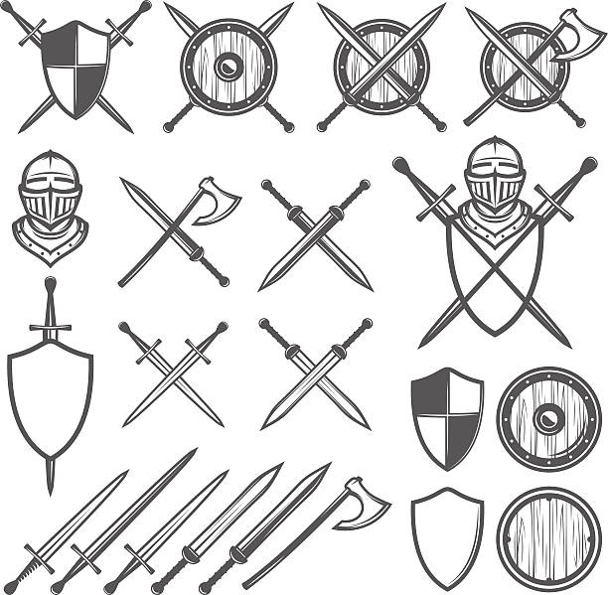
Most needed Assets
This is what I mean by ornamentation,
but a little bit more subtle
Something like this, but again
More subtle like
Iconography something of this
style

